Slide 1
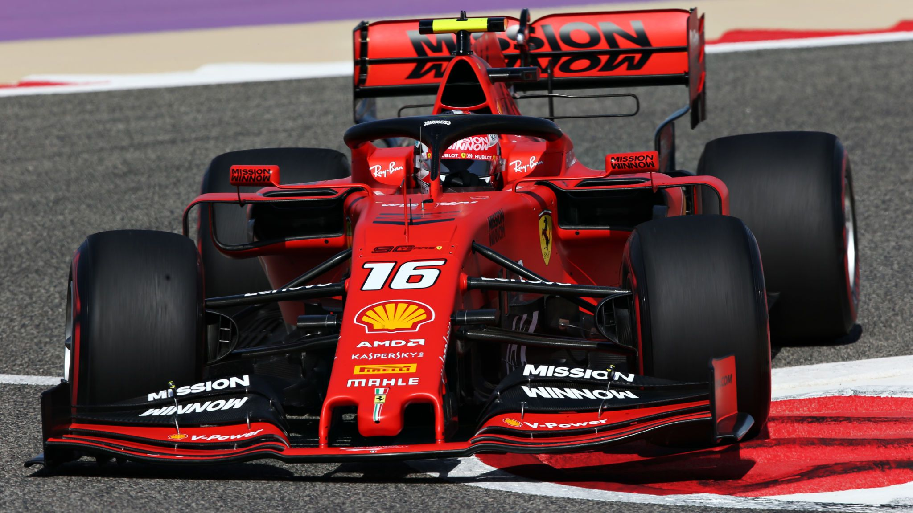
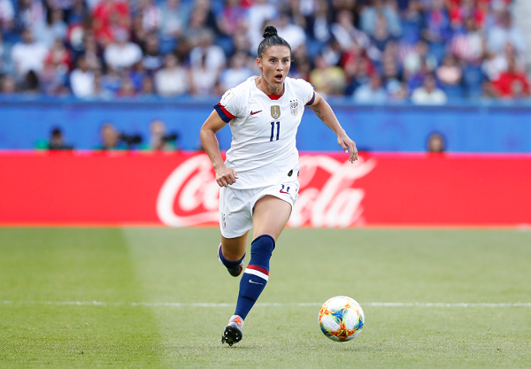
ad.value()
Romeo Rivera, Dat Tran, Furkan Toprak
Notes:
Describe the general premise of the project. Advertisements are a part of human’s everyday life, we see them from when we’re children to when we’re old.
Remember the as seen on TV ads you saw as a kid? Slap chop, Slushy magic, chia pets. (talk about influence on children)
That’s a bit on how ads affect us, but the question arises, what is the “value” that companies gain from these ads?
This leads me to the purpose of the project

Slide 2

Purpose
Understanding the actual value of on-screen advertising by using parameters such as:
Time visible
Volume of advertisements
Frequency of advertisements
Notes:
Advertisers paid:
five million for thirty second super bowl commercials
Up to seventeen million for liveries on f1 cars
What type of value do these investments bring to the companies paying for them?
There isn’t any publicly available technology to determine this value so our team decided to tackle this problem
In confronting this problem we decided that these three factors are most important in determining value: (say factors)
The reason that we chose time is because visible time on screen is precisely what the advertisers are paying for, exposure, amount of air time.
Volume of advertisements is the amount of times the ad is seen on screen in a frame. This is important because the more something is available on screen, the more likely it is to be seen/talked about
Frequency of advertisements is considered an important metric because the more often an advertisement is seen, the more that the logo is solidified in memory
Now that we talked about why to do the project, my teammate Furkan will explain the framework and how we used data

Slide 3
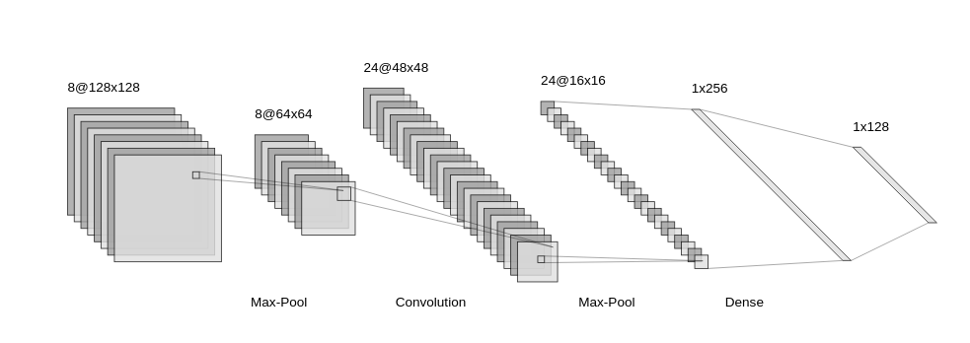
Framework
Object Detection:
Find a Machine Learning Model that is able to efficiently and reliably identify images.
Design the model within ~24 hours.

Slide 4
Framework
Analytics:
Identify the volume, frequency, and screen time of advertisements.
Associate volume, frequency, and screen time with a cost for advertising.

Slide 5
Framework
Eventually:
Come up with a negotiative algorithm/equation that barters a price for TV advertisements that factors in volume, frequency, and screen time.
Split the advertising profits with TV networks, actors/athletes, and teams.
(Game Theory?)

Slide 6
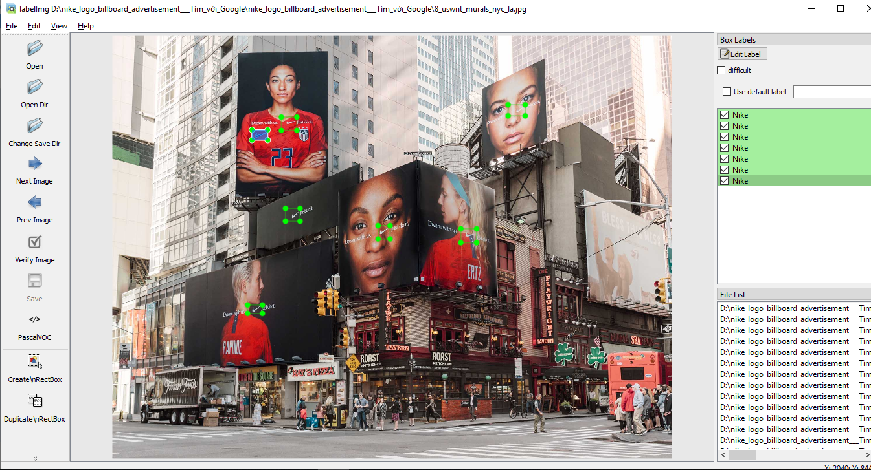
Data Use
Webscraped thousands of images from companies such as Coca-Cola, Nike, Adidas, Shell, Walmart, and Pepsi
Refined the data by removing duplicates, irrelevant search results.
Labelled the data and annotated with the company’s name.
We love bad data!
Logos on a slant, bad lighting,
low resolution need to be trained on!

Slide 7
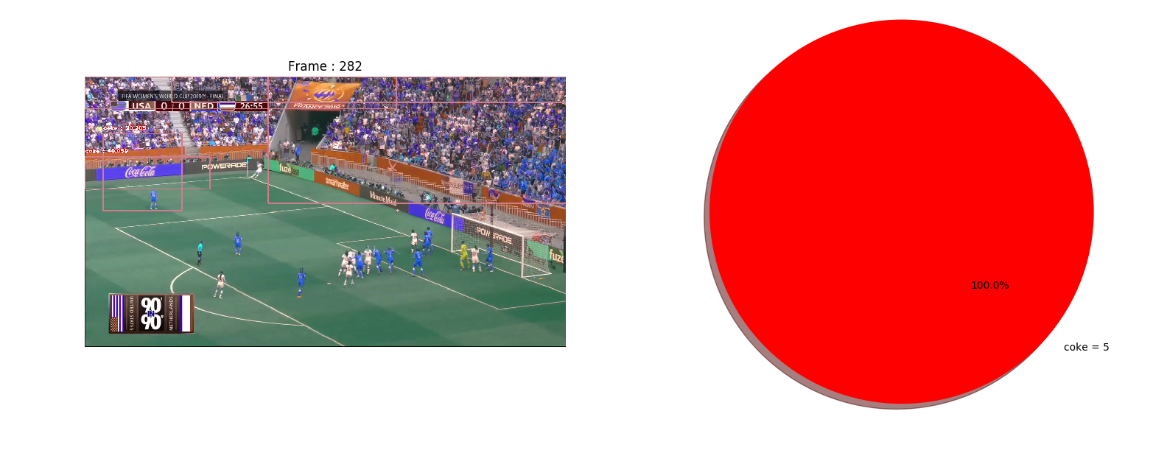
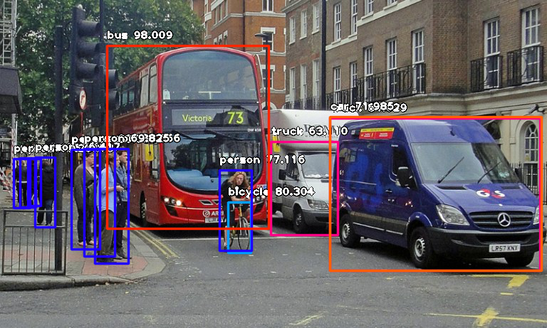
Models and Analytics
YOLOv3
Pretrained object detection model provided by imageAI
Convolutional Neural Network optimized for Object Detection in images and videos.
Under the hood:
Tensorflow and Keras
Lots of JSON-, XML-, and image- analyzing algorithms.
Notes:
Understanding the actual value of on-screen advertising by using parameters such as the time advertisements are seen and the volume in which they occur.

Slide 8
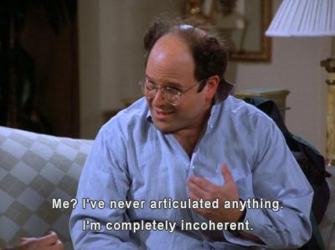
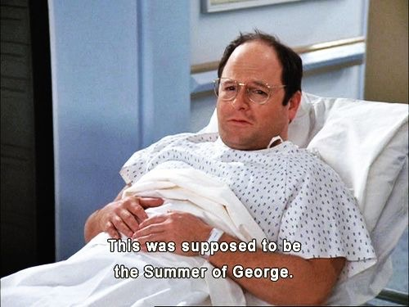

Models and Analytics
Our model sucks! For now!
Not enough time to train:
5% of the actual required training time.
Only detects one company
Not so accurate
Even our logo sucks; insufficient time
Notes:
Understanding the actual value of on-screen advertising by using parameters such as the time advertisements are seen and the volume in which they occur.

Slide 9

Validation
Validated the model using 2 videos to see how well it works on detecting validation data
Notes:
Understanding the actual value of on-screen advertising by using parameters such as the time advertisements are seen and the volume in which they occur.

Slide 10
Impact
Advertisers can quantify the value of investments
Teams are able to gain more sponsor value based off of our metrics
Find an objective methodology to measuring the impact of TV advertisements.
Notes:
Monetary value of advertisements can be better leveraged by both the teams and the advertisers
Teams:
Advertiser approximated value allows for teams with increased exposure to
Produce more revenue
Grow team infrastructure
These things allow for the teams to be better funded and to gain value
Advertisers:
Advertiser approximated value allows for advertisers to
Make more educated investment decisions
Gain more insight into metrics of their investments

